Slide 1
Tarun Annam
Final Project
3/21/2024 Annual Review

Slide 2
KEY LOGGER AND SECURITY
3/21/2024 Annual Review

Slide 3


AGENDA
Understanding Key Loggers
How key loggers work
Risks and Implications
Detection and Prevention
3/21/2024 Annual Review

Slide 4

PROBLEM STATEMENT
Addressing Key Logger Threats in Information Security
3/21/2024 Annual Review

Slide 5

PROJECT OVERVIEW
Increase Awareness and Education
Enhance Detection and Prevention
Ensure Legal and Ethical Compliance
Improve Incident Response
3/21/2024 Annual Review

Slide 6

WHO ARE THE END USERS?
1. Employees
2. Security Team
3. Management and Executives
4. Legal and Compliance Team
5. External Stakeholders
3/21/2024 Annual Review

Slide 7

Enhancing Security Against Key Logger Threats To address the risks posed by key loggers, the proposed solution involves a comprehensive approach encompassing awareness, detection, prevention, compliance, and incident response. This multifaceted strategy aims to protect sensitive information and maintain the integrity and trustworthiness of the organization’s digital infrastructure.
Solution and Value Proposition
3/21/2024 Annual Review

Slide 8

Cutting-Edge Innovation and Comprehensive Protection 1. Advanced Behavioral Analysis: Machine Learning Algorithms: Utilizing state-of-the-art machine learning algorithms to analyze user behavior in real-time, detecting subtle anomalies that traditional methods might miss. Predictive Analytics: Leveraging predictive analytics to identify potential threats before they can manifest into actual attacks, providing a proactive defense mechanism.
Key Logger Security Enhancement
3/21/2024 Annual Review
8

Slide 9
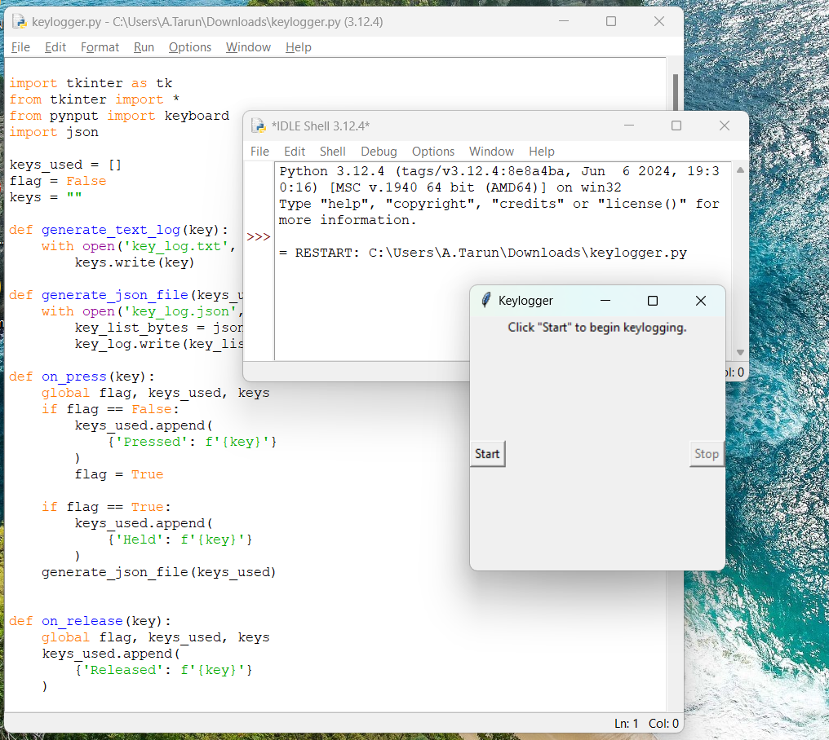
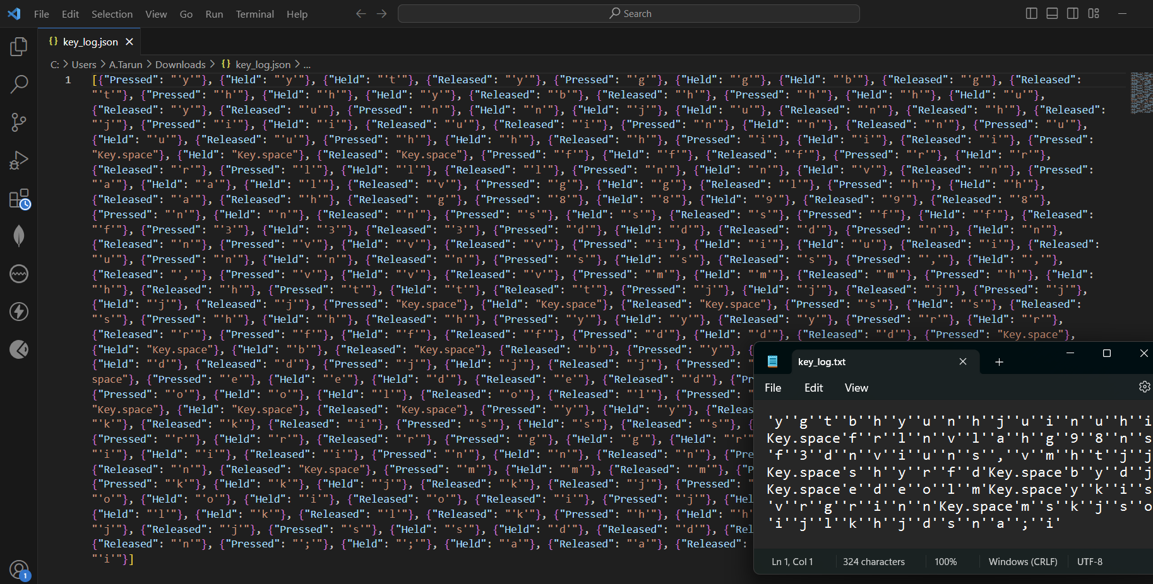
DEMONSTRATION
3/21/2024 Annual Review
9

Slide 10
RESULTS
1. Improved Threat Detection and Mitigation
2. Enhanced Prevention Mechanisms
3. Efficient Incident Response
4. Increased Awareness and Education
5. Compliance and Ethical Assurance
3/21/2024 Annual Review
10

Slide 11
Git Hub Link
https://github.com/AnnamTarun/keyloggertarun

